Slide 1
Traction – A Long Read LIMS
Harriet Craven
Steve Inglis
Notes:
Why: Steve
How: Harry
Now: Steve
Coming soon: Harry
Michelle quote why and how lims helps
Speak to Naomi - external facing
Tree of Life stats
Craig quote about the multiplex spike meeting
Michelle quote about what Saphyr does
Karen quote about what Pacbio does
Quote from Karen about future ONT and Pacbio
Icon
Inbound logistics as opps -> outbound

Slide 2
WHY

Slide 3
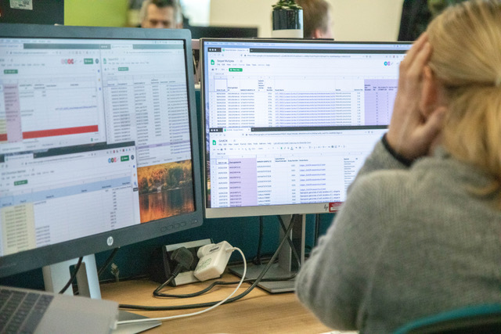
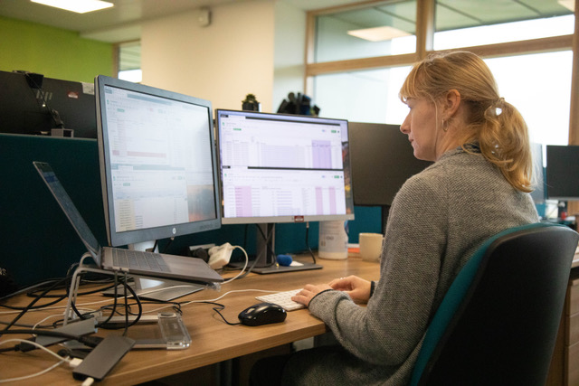
"We need a LIMS so that my full time job is not inputting info into Google Sheets"
“We have gone from tracking 10s of PacBio samples per month to trying to keep on top of >35 per month. When we start processing >35 per week it will be a close call between google sheets breaking or one of the team. Place your bets...”
Notes:
This is Karen. I have been in the same office as Karen for 3 years and throughout that whole time she has been crying out for a LIMS to track her work.
It has never been a priority because her work is bespoke and low throughput.
That has all changed …
Karen: "We need a LIMS so that my full time job is not inputting info into Google Sheets”
Craig: “We have gone from tracking 10s of PacBio samples per month to trying to keep on top of >35 per month. When we start processing >35 per week it will be a close call between google sheets breaking or one of the team. Place your bets...”

Slide 4
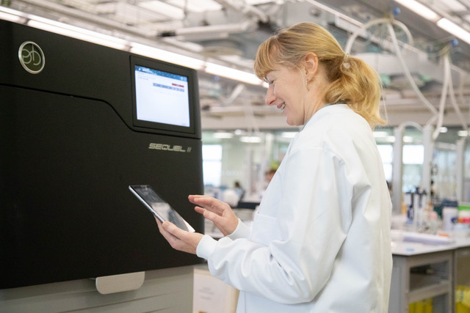
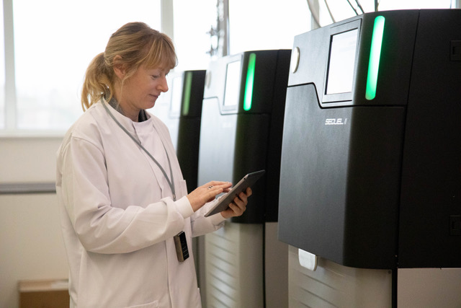
First there was Excel , then Google sheets, finally Traction
Notes:
This is how we envisage life for Karen with a LIMS which allows her to track her work.
In her natural environment; in the lab, looking happy and no Google sheets!
Just an iPad with LIMS and a 2D scanner.

Slide 5
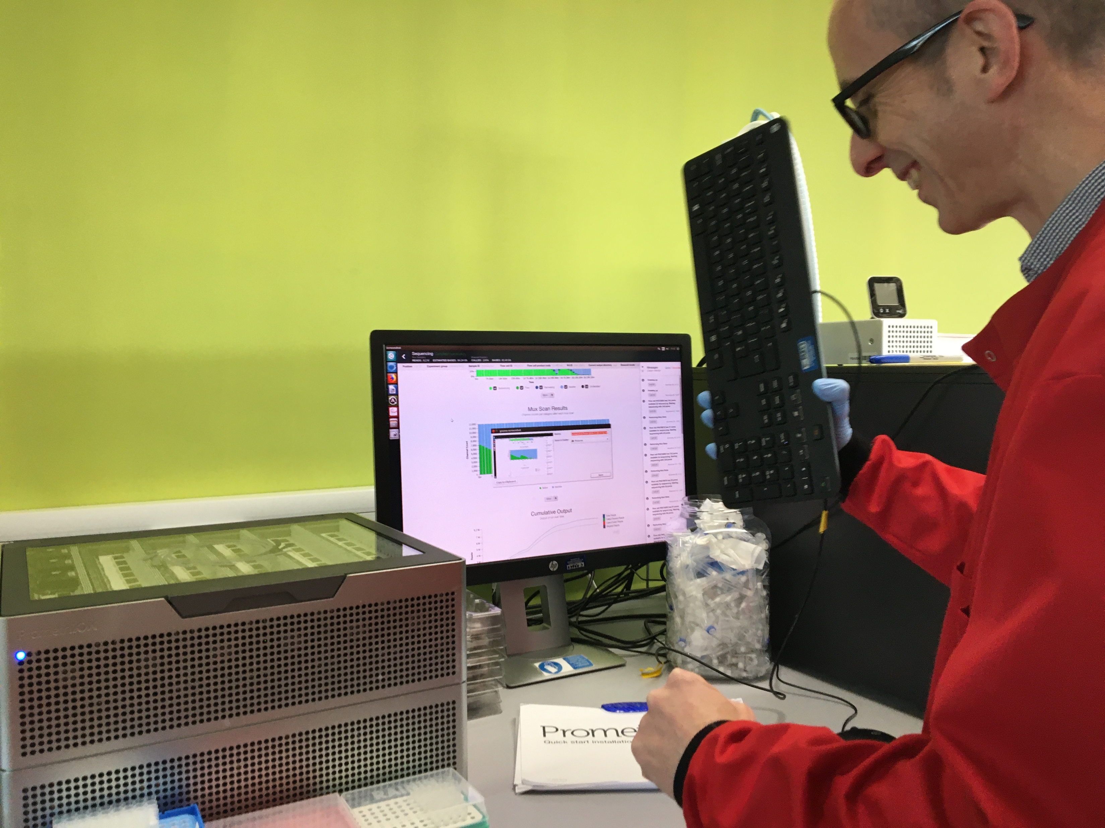
New Pipeline Group (NPG) | DNA Pipelines Informatics
We need to know what, when and where …
Notes:
This is Keith. Keith works in NPG.
He needs to be able to match sample data, for example what biological material has been loaded in which flowcell and the origin of those samples, against the sequencing data.
He also needs to make sure that they have got all of the data and what runs to expect.
At the moment he has to do this manually and as you can see he gets frustrated.
a LIMS will help him to gather the data in a more maintainable and less time consuming way.
No Promethions were hurt in the making of this image.
Keith:
What is missing from the current data gathering
Will LIMS be able to help
What Tracton delivers to NPG / faculty delivery
Buisness impare of traction for NPG
Traction gives NPG a way to know what runs to expect on the machine
NPG can physically look at what is on the disk
Can compare that to what is in Traction to make sure they have got all the data
Need to know what, when and where
Get that information from the MLWH, which is inserted from Traction
NPG need to know …
Need to know what, when and where
Get that information from the MLWH, which is inserted from Traction
Use the data that Traction puts into the MLWH
NPG want to know what biological material has been loaded which flowcell
NPG identiy the origin of samples which is loaded onto the oxford ONT tehnologies
Timestamps from files
And gives NPG a way to know what runs to expect on the machine
NPG can physically look at what is on the disk
Can compare that to what is in Traction to make sure they have got all the data
Currently, without Tracton
To know what the sample is currently,
Collobrate – fields in the MLWH table
Make sure the required fields
Discussed the fields in the table to make sure data NPG required was inserted

Slide 6

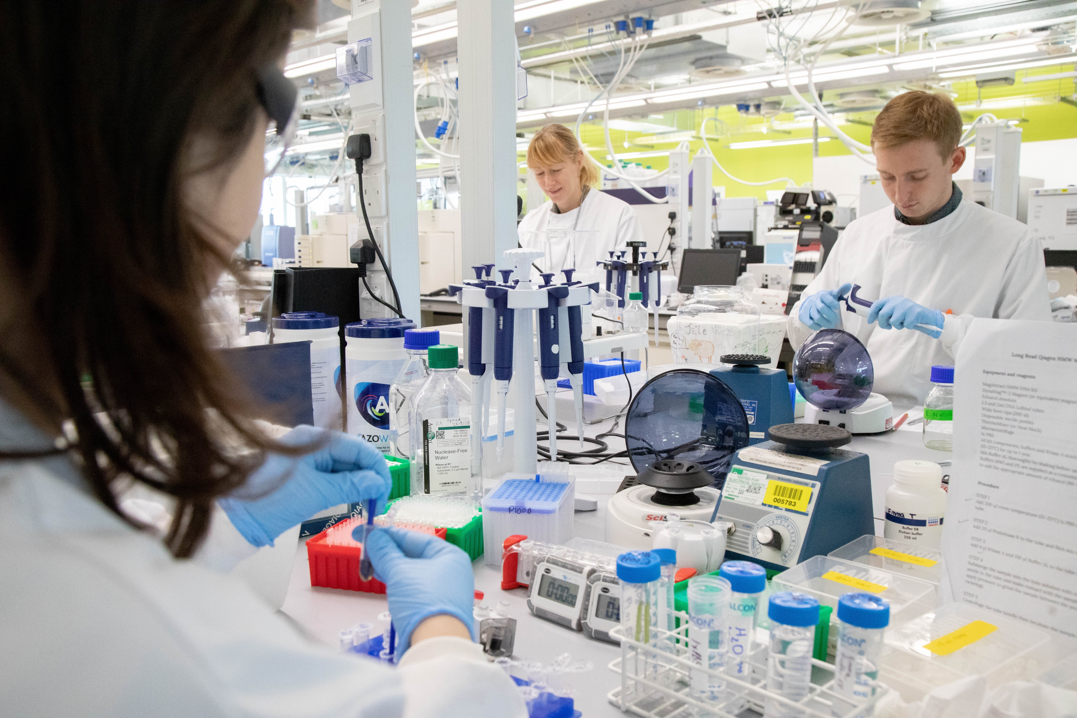



Faculty
R & D
Operations
External Partners
Notes:
Four different areas to address: operations, faculty, external partners, R & D
Operations
Need a central place to track long read samples.
Why not Sequencescape? Tried to use it but it was a bit like a ‘square peg in a round hole’. Sequencescape is built for short read Illumina sequencing.
Tree of Life – process 66000 samples over 10 years
R&D
With LIMS tracking we will have all of the historical data e.g. method of extractions which we can correlate with the sequencing data to give us an idea of how we can improve pipelines in the future.
Faculty
Need to know:
- the sample that went in matches the data that came out
- where the sample are in the workflow e.g. QC
- Correlate sample with output
- whether there is still sample material left for further analysis
With a LIMS we can give them all of this information via SSRs.
External Partners
The Sanger Institute will serve as a hub for sequencing and genome assembly, annotation, data storage and data release. LIMS will be a crucial part of that.

Slide 7
HOW

Slide 8
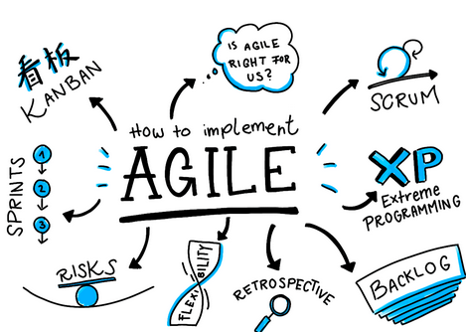
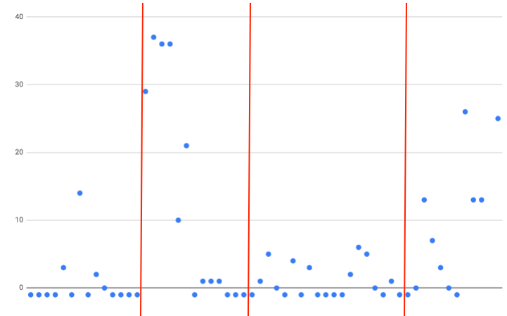
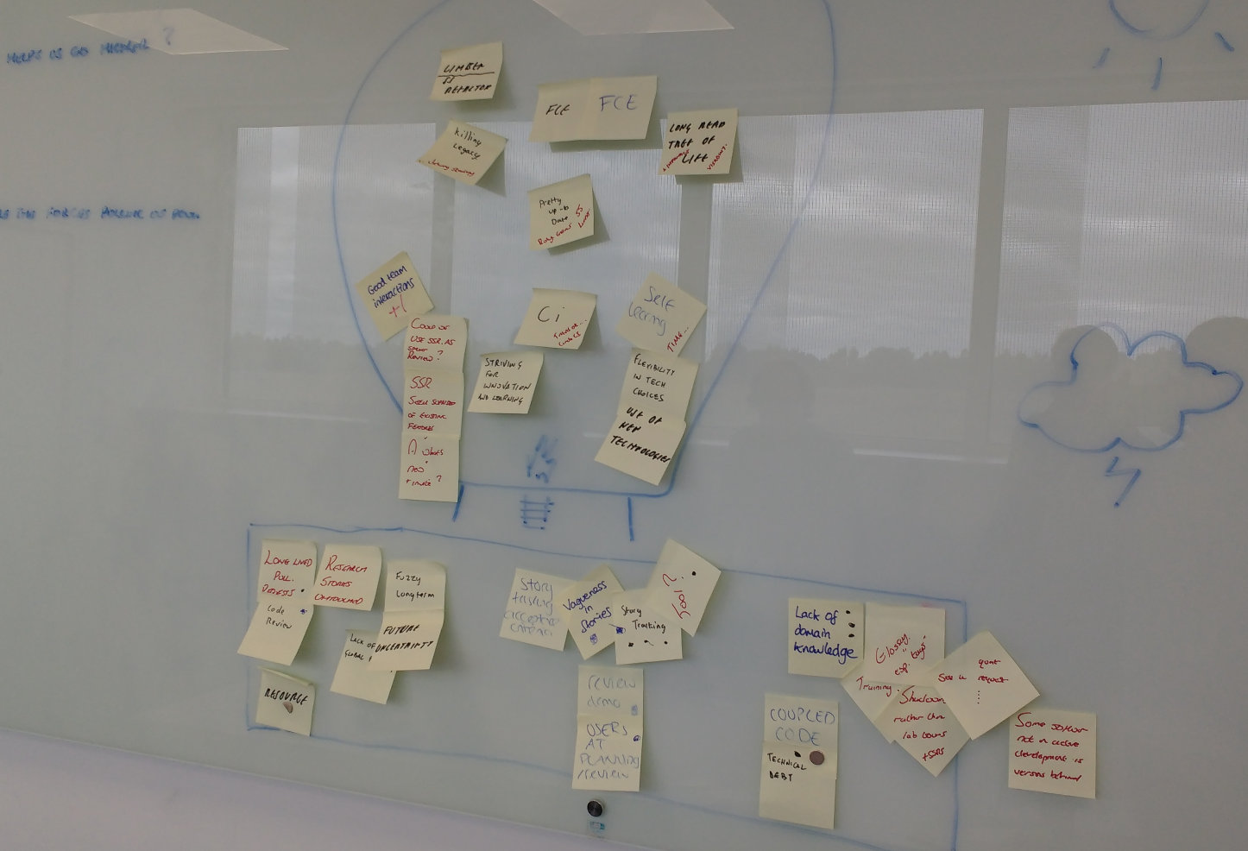
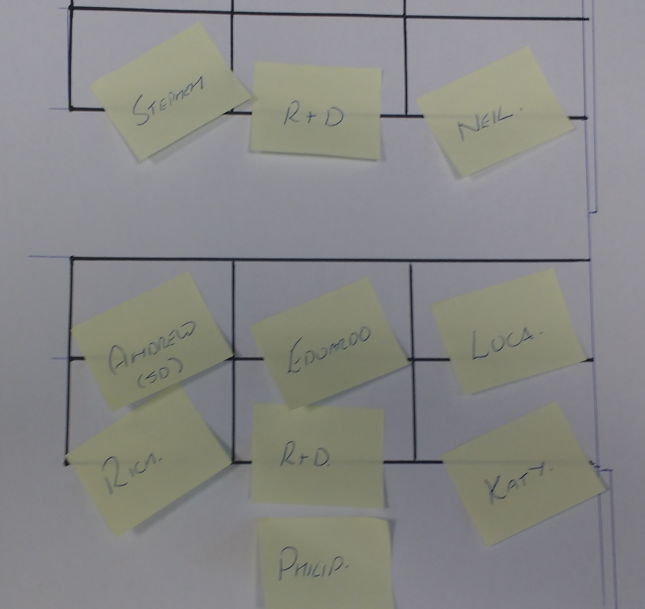
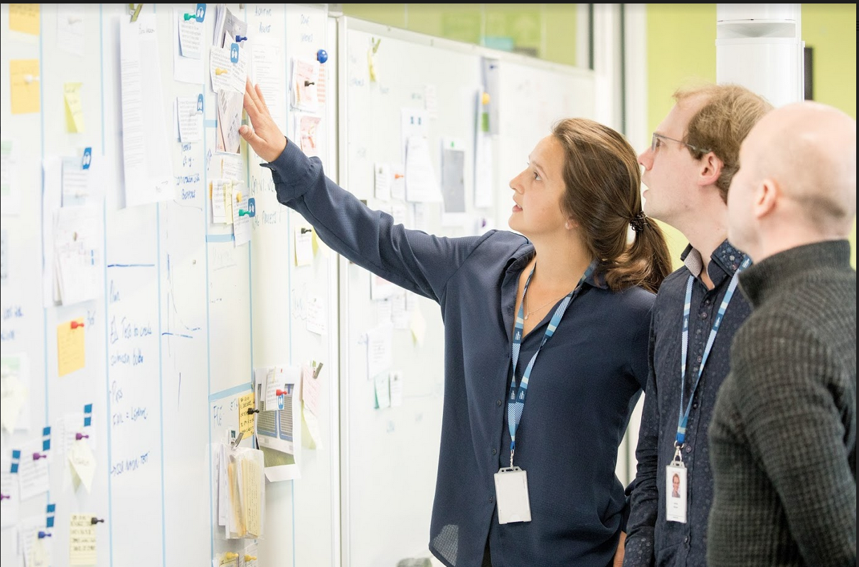
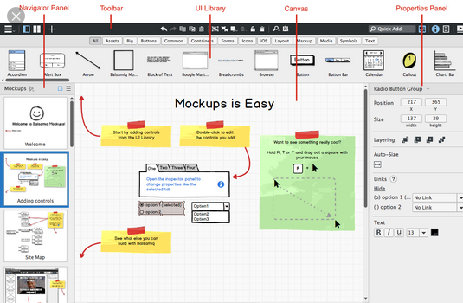
Development Process
Notes:
Agile
Sprint
Planning
Stand ups
Stories
Tasking
Prototyping
Code review
Merge
Deploy
Test
UAT
production
Lots of image of techy processes
ACTIONS:
Get pictures from Mark of stand ups

Slide 9
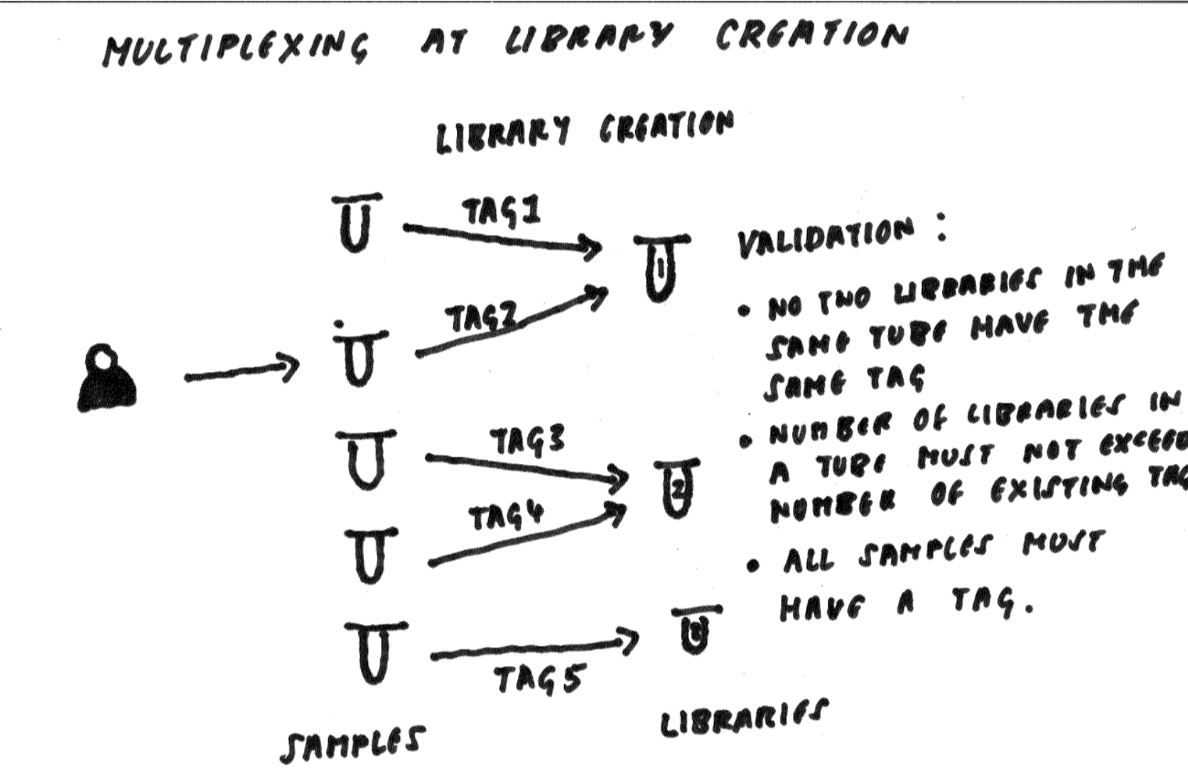
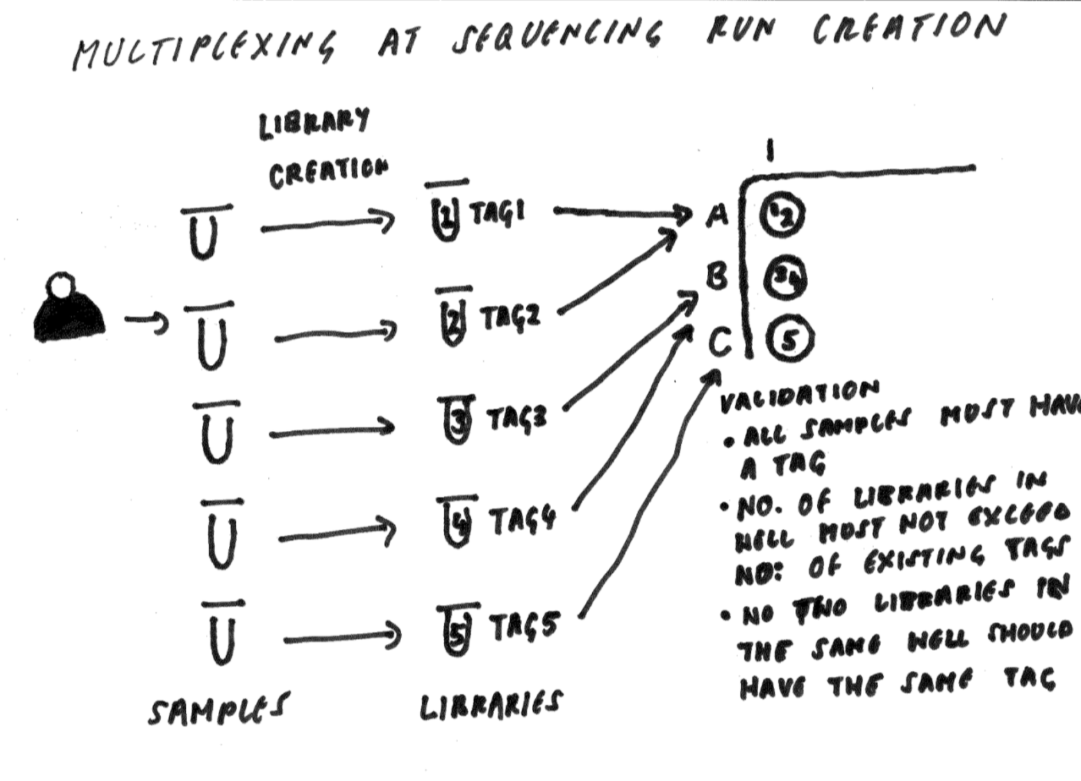
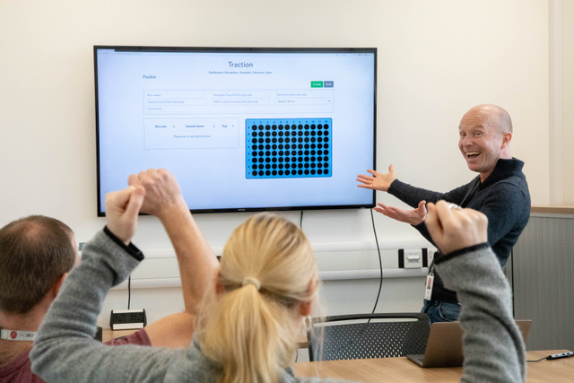
Customer Interaction
Notes:
Customer interaction
Understanding their process
Design meetings
UAT
Regular feedback
Lab walk through with software
We recently did a spike for PacBio multiplexing. Craig said it was brilliant because it allowed us to visually communicate how the process worked and decide exactly which features were necessary in LIMS. We realised from this meeting that they only needed to add Multiplexing at Sequencing Run creation which saved both sides a lot of time and effort and meant that we could get to MVP much quicker.

Slide 10



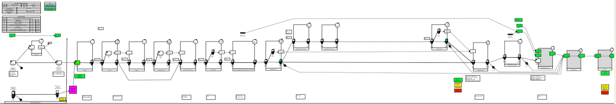
What we learnt to do better
Notes:
Internal
How we learnt to improve our software development process
Team – try to remove ambiguity
Better planning
Taskings
MVP
Slack
Communication
External
Communication
Two images
1 wrong software
2right software
Process maps - Mapping out the process
Ideal
Quote from Craig
Image of spike planning
Team improve developer process
Tasks
explicit
Driven by barcodes
From that, started to communication more and earlier
User needs
ACTIONS:
Speak to Craig about last spike meeting
Image of the multi plex

Slide 11
NOW

Slide 12


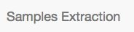

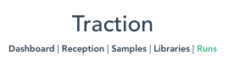
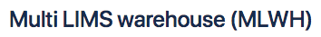
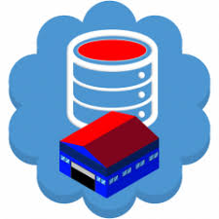
Architecture
Notes:
What services Traction is currently speaking to
SS -> SE -> Traction -> WH
Information is provided from the customer in sample manifest which is uploaded to Sequencescape with associated metadata. Samples are generated and attached to studies and projects.
For info:
Sequencescape – Inbound logistics
Samples extraction / Traction – Operations
MLWH – Outbound logistics
Inbound logistics – recording scientific objectives and data release policy. Receiving material from collaborators with material provenance.
Operations – recording process through genomic and cellular pipelines. Reporting of material progression and inventory queues. Capturing changing points and updating finance systems.
Outbound logistics – Marshalling identifier information and product metadata to the warehouse to facilitate downstream processing.

Slide 13
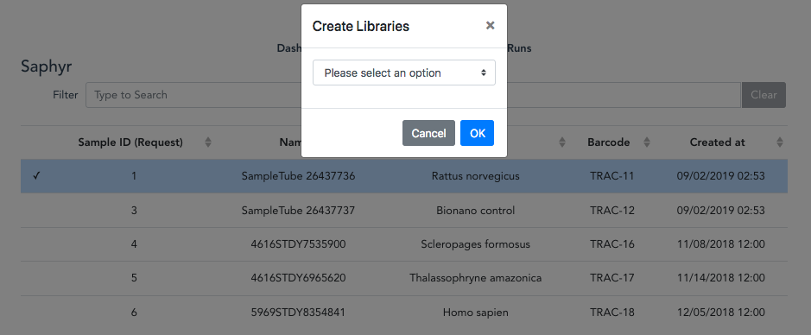
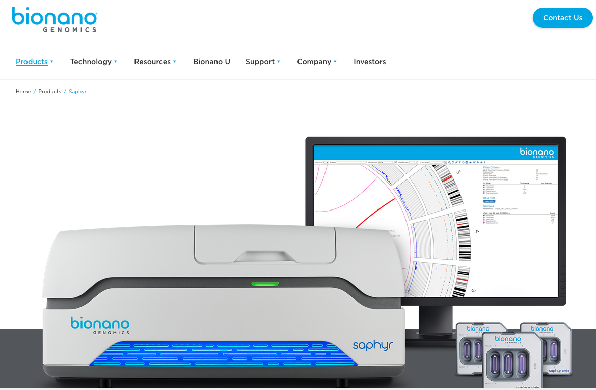
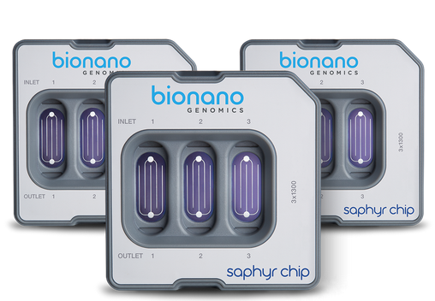
Saphyr
Notes:
Went live 6 months ago
Only 23 runs in Saphyr
Nothing recently because of Saphyr instrument faults
Unfortunately no samples have gone through the Saphyr pipeline recently due to instrument faults. The software has recently been updated which allows a bigger throughput per chip and they are going to do a troubleshooting run to ensure the instrument is working ok. The problem could be related to samples, chip or reagents so the plan is to recommence samples so hopefully the pipeline could be up and running again soon.
For info: Bionano genome mapping can improve assembly contiguity and accuracy and can reduce the amount of sequence coverage needed, reducing cost. Adding Bionano maps to sequencing data enables you to view whole genomes in context.
Traction allows her to:
- Import samples from samples extraction
- Create libraries
Create runs
Information is automatically exported to the warehouse when a run is created.

Slide 14
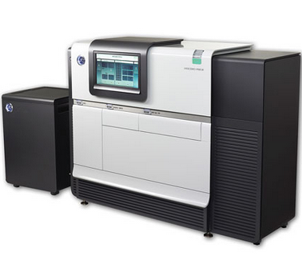
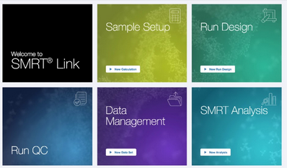
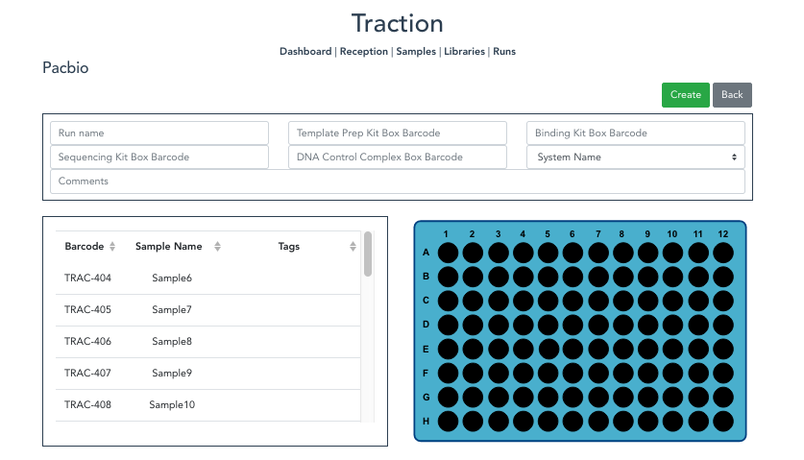
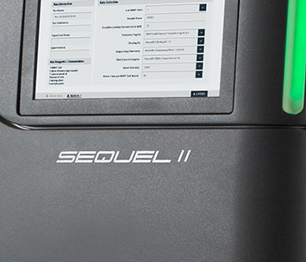
Pacbio
Notes:
Pacbio (screen shots of the below)
What it does …
Traction allows them to:
Import samples from samples extraction
Create libraries
Create runs
Generate sample sheets for importing into SMRT link
when a run is created data is automatically exported to the warehouse
Went live on November 21st
First 2 samples were created on November 27th
Libraries should be created this week
First run in before Christmas
ACTIONS:
Get quote from Karen about Pacbio and what it does

Slide 15
COMING SOON

Slide 16

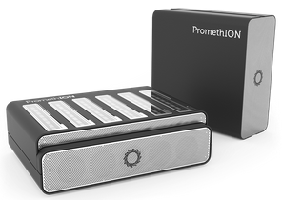

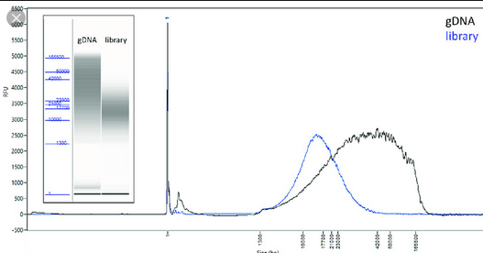
ONT and Pacbio
Notes:
PacBio
Multiplexing – currently being worked on as we speak should be released early January
Add tracking support for QC and femto pulse – should be delivered second quarter on 2020
ONT
Promethion – sample reception, QC, library and run creation, data export to warehouse (work starting in January 2020)
Multiplexing?
Gridion – move functionality from old traction
Collaboration - Genomics England are looking to scale up their Promethion work, and are looking to collaborate with us
Automation – as throughput increases it will become crucial. It will allow us to create runs via the API which prevents duplication of effort and extract information about runs to provide live updates of how runs are progressing and …
ACTION:
Image of femto pulse (images)
Image of automation and Tree of Life
Speak to Karen
Visualise QC tracking for pacbio – find out how to picture QC
Image of femto pulse (images)

Slide 17
THANK YOU
Notes:
Thank you’s to…
Long read team: Karen, Craig, Emma, Michelle
NPG
R&D
Rich
Phil
Luca
FCE support
Mark Danson for the photos
We will now pass you onto Andrew who will concentrate on processes and science.

